Slide 1
EFFICIENT RESOURCING AND EFFECTIVE GOVERANCE THROUGH SCHOOL COMPLEF/CLUSTER 3.7
NAME :- NAVIN KUMAR HM
MOBILE NO :- 9199475639, 9431857611
EMAIL ID :- navinkumar959@gmail.com
SCHOOL :- +2 UHS TARALAHI, HANUMANNAGAR, VILLAGE-SANTPUR TARALAHI, DISTT- DARBHANGA, (BIHAR) PIN-846003.
SCHOOL WEBSITE :- www.uhstaralahi.com
SCHOOL :-EMAIL ID :- uhstaralahi2012@gmail.com
SCHOOL DISE CODE :- 10131302202

Slide 2
WHAT IS INNOVATION
TO DEVELOP SCHOOL AMBIENCE (ENVIRONMENT)
TO DEVELOP SCHOOL INFRASTURE
TO DEVELOP TEACHER SUPPORTING NATURE
TO DEVELOP AND FUNCTIONAL STUDENT COMMITTEE(BAL SANSAD, MEENA MUNCH, ECO CLUB,YOUTH CLUB,STUDENT SEFTY GROUP)
TO DEVELOP BEST RELATIONSHIP WITH PARENTS AND SCHOOL COMMITTEE
TO DEVELOP SCHOOL WEBSITE----www.uhstaralahi.com

Slide 3
TO DEVELOP LEARNING ENVIRONMENT IN CLASS ROOM WITH USE OF SMART CLASS, USE OF LAB. USE OF LIBRARY, USE OF TLM, USE OF SPORTS EQUIPMENTS AND OTHERS
TO DEVELOP HABITS OF STUDENTS TO USE SOAP BANK ,PAD BANK ,FIRST AIDS AND MASK BANK ,TLM BANK AND SPORTS EQUIPMENTS
TWINING OF SCHOOL WITH OTHER GOVT. SCHOOL TO SHARE RESORCE
TO DEVELOP SCHOOL CAMPUS AS “SAMAJIK CHETNA KENDRA”
TO DEVELOP UTILIZATION OF INFRASTRUCTURE IN DIFFERENT ACTIVITY

Slide 4
SALIENT FEATURE OF THE INNOVATION
LEARNING OUTCOME THROUGH ICT LIKE –SMART CLASS, MOBILE APP, MERA DURDARSHAN MERA VIDAYLAY ,e-LOTS APP
OUR WEBSITE www.uhstaralahi.com DIRECTLY LINK WITH e-LOTS APP AND MERA DURDARSHAN MERA VIDAYLAY OF BEP WEBSITE.
CLASS TEACHER DEVELOP WHATS UP GROUP OF STUDENT AND HIS PARENT MOBILE NO. TO SHARE MESSAGE
BY WHATS UP GROUP DEVELOP BRIDGE BETWEEN STUDENT TEACHER AND PARENTS FOR LOWER COMMUNICATION GAP
RETATION RATE OF STUDENT INCREASE FROM 52% TO 68%
USE OF ICT TOOLS INCREASE PERFORMANCE RATE OF STUDENT
WI-FI FACILITY AVAILABLE IN SCHOOL CAMPUS

Slide 5
INNOVATION BENIFITED TO STUDENT (POSITIVE IMPACT)
AVAILABLE OF BENCH DESK FROM CLASS 8 TO 12 MAXIMUM OWN RESOURCES
AVAILABLE OF DARI FROM CLASS 1-7 IN CLASS ROOM AND OTHER ACTIVITY OUT OF CLASS ROOM
AVAILABLE OF TLM BANK FOR ALL CLASS SUBJECT WISE
USE OF SOAP BANK , PAD BANK , MASK BANK & FIRST AIDS KITS HABITS DEVELOP IN STUDENT
STARTING SCIENCE LAB. FOR CLASS 6-8 BY OWN RESOURCE
STARTING LIBRARY FOR CLASS 1-8 BY OWN RESOURCE & DEVELOP READING CORNER IN LIBRARY ROOM
STARTING PLANTATION WITH HELP OF ECO CLUB &OTHER STUDENT COMMITTEE

Slide 6
FUNCTION OF STUDENT COMMITTEE LIKE –BAL SANSAD , MEENA MUNCH ,YOUTH CLUB , ECO CLUB , SCHOOL SAFETY GROUP ACCELERATE TEACHER & STUDENT IN MANY OTHER ACTIVITY IN SCHOOL CAMPUS
11 TYPE OF SPORTS KITS AVAILABLE TO USE BY STUDENT IN SCHOOL PERIOD
YOUNG COMMUNITY PEOPLE USED SCHOOL GROUND OFF HOURS IN DIFFERENT SPORTS ACTIVITY & OTHERS ACTIVITY SO THAT SCHOOL CAMPUS DEVELOP AS “SAMAJIK CHETNA KENDRA”

Slide 7
TWINNING OF OTHER SCHOOL
BY SUPPORT OF BEP DARBHANGA A GROUP OF 21-MODEL SCHOOL SELECTED IN DISTT. ALL SCHOOL HM & ONE NODAL TEACHER VISIT & SHARING THOUGHT EACH OTHER EVERY MONTH BY ROTATION .THIS HELP TO SHARE RESOURCE & COLLABRATE WITH OTHER SCHOOL.
IN CRC LEVEL TWINNING OF OTHER SCHOOL TEACHER AND STUDENT TO SHARE IDEA WITH BAL SANSAD AND OTHER STUDENT COMMITTEE .PARTICIPATE IN CLASSROOM LEARNING ,SCIENCE LAB, SMART CLASS , LIBRARY ACTIVITY & OTHER LEARNING CORNER.

Slide 8
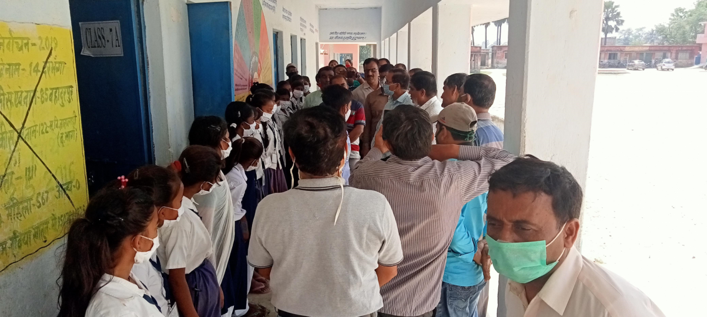
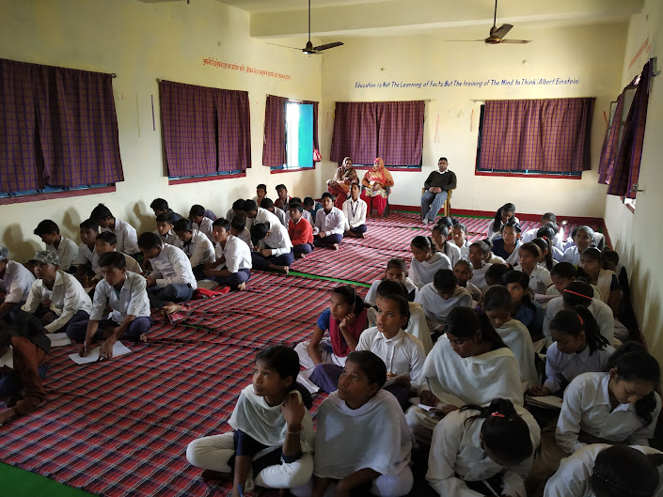
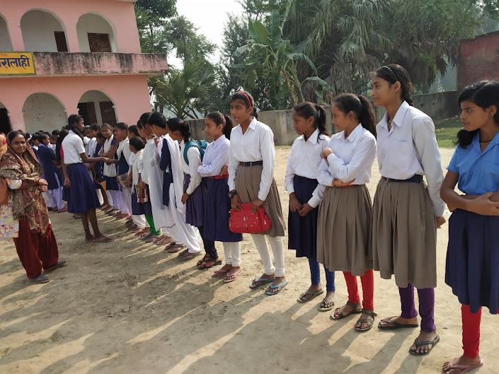
PHOTO FOR TWINNING OF SCHOOL

Slide 9
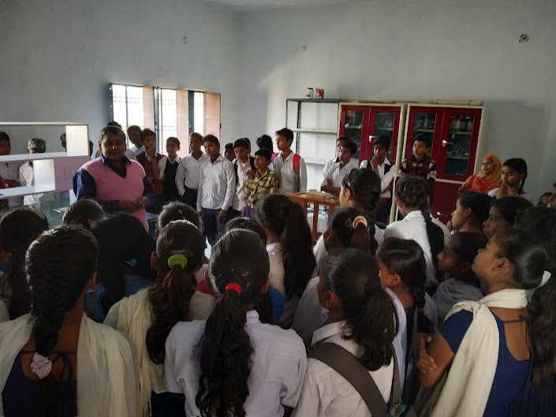
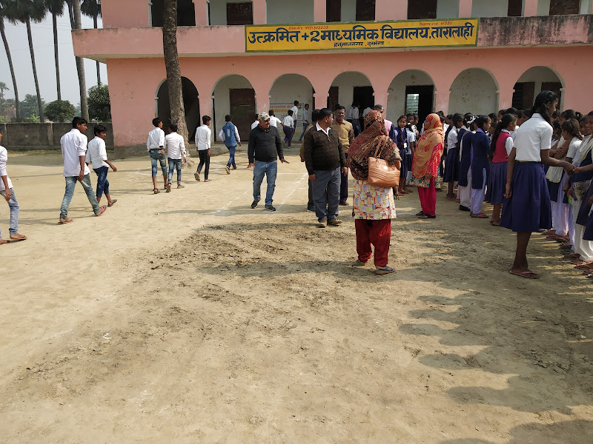
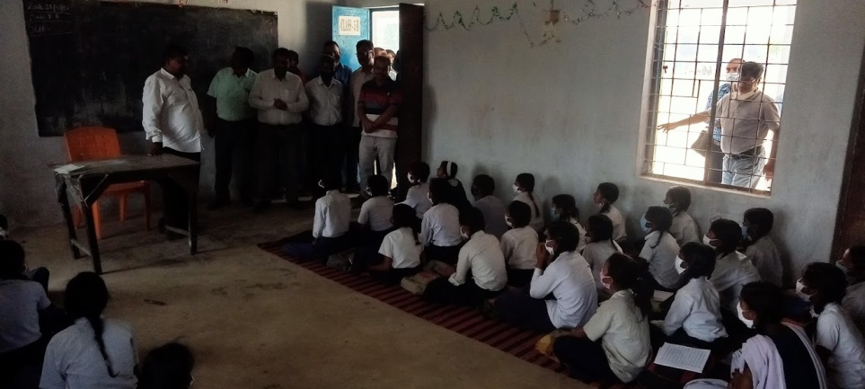
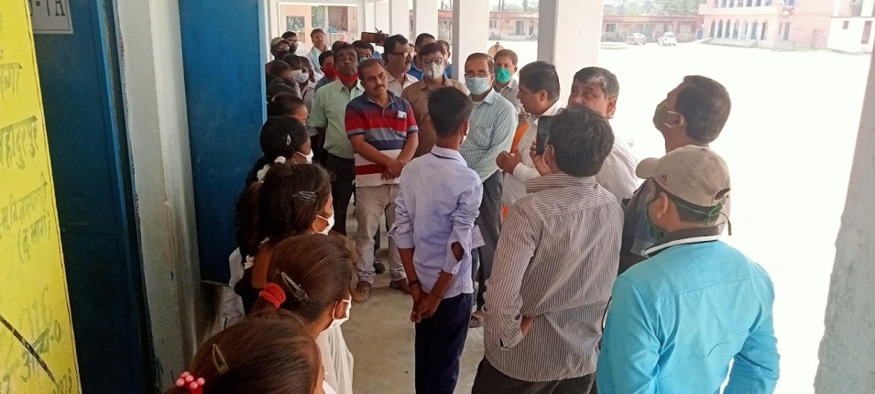
MODEL SCHOOL HM TALKING WITH STUDENT & ITS COMMITTE

Slide 10
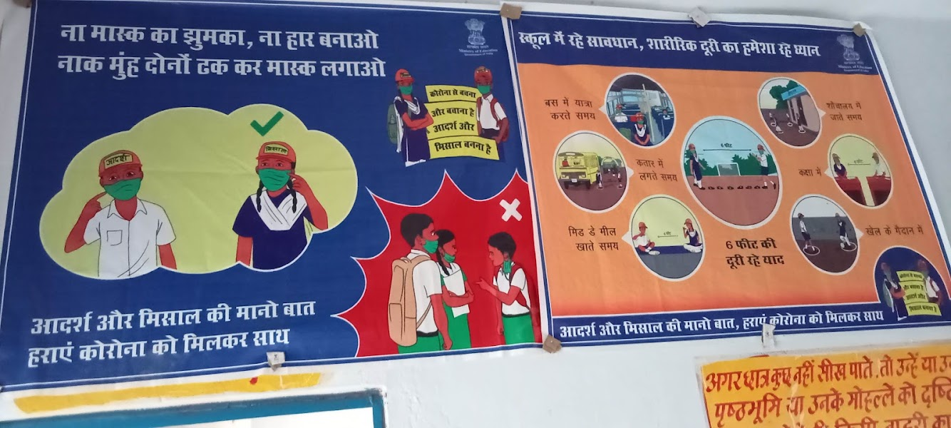
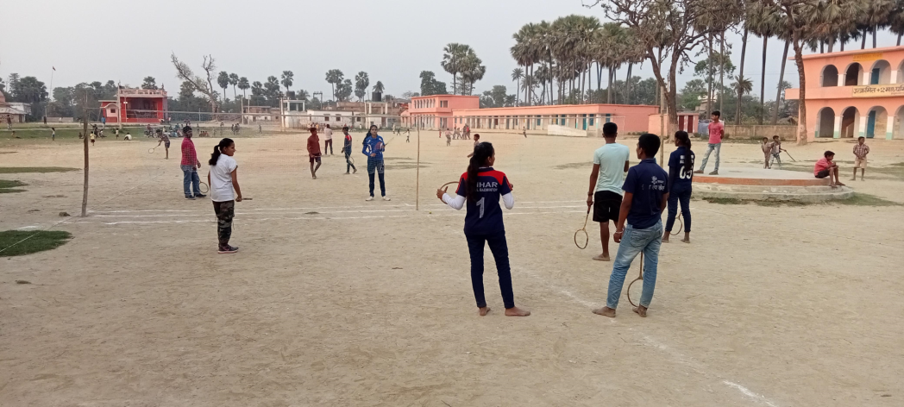
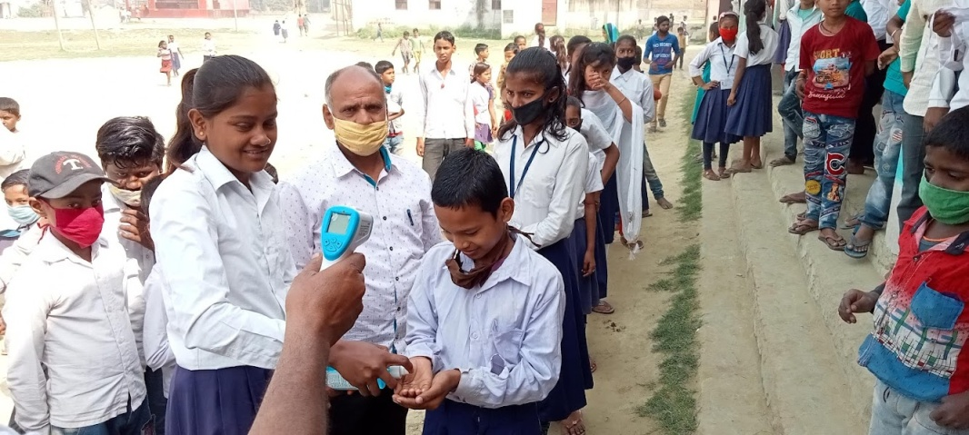
SAMAJIK CHETNA KENDRA ACTIVITY PHOTO

Slide 11
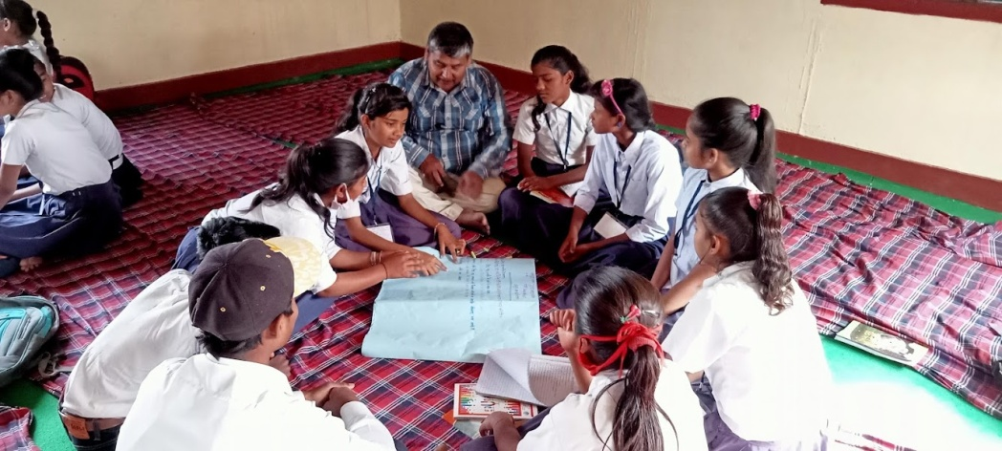
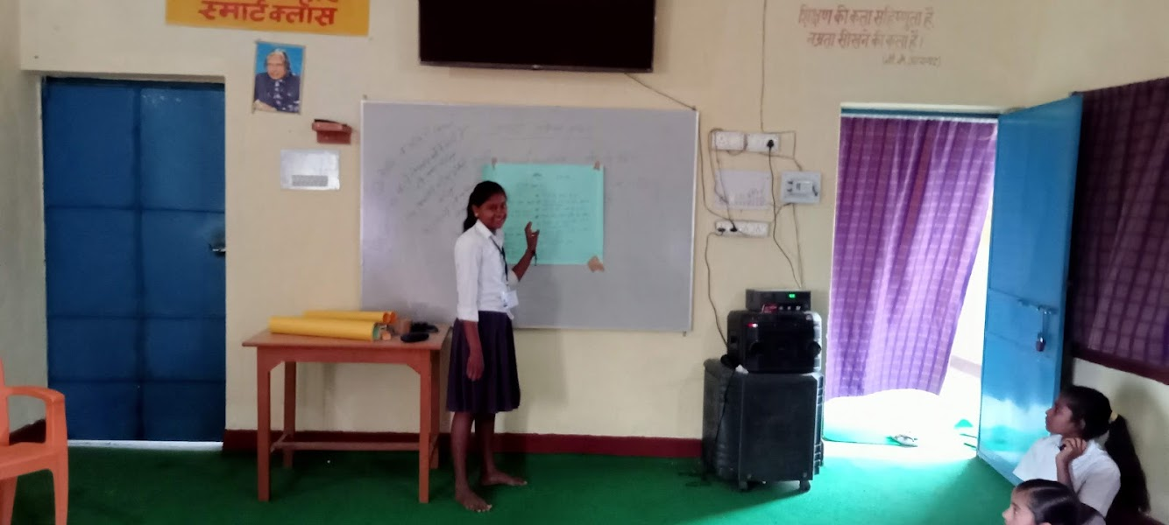
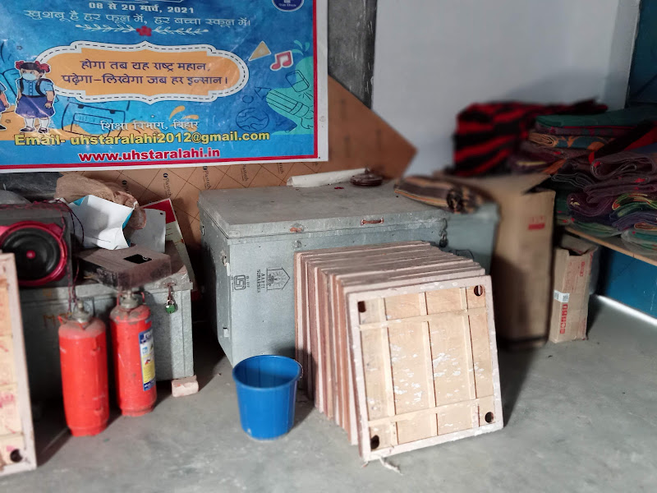
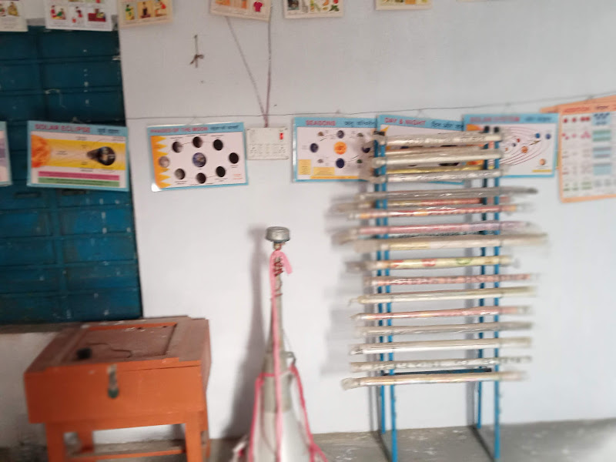
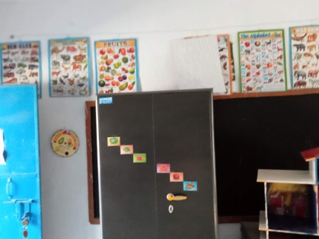
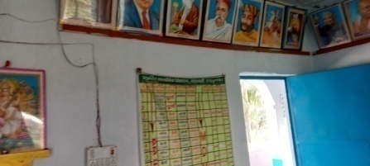
SAMAJIK CHETNA KENDRA OFF HOUR SCHOOL PERIOD

Slide 12
CHALLENGES
TO MOTIVATE SCHOOL TEACHER
TO MOTIVATE AND SUPPORTING NATURE DEVELOP IN VSS & OTHER STAKE HOLDER
LACK OF RESOURCE LIKE—UNAVAILABLE SCHOOL BOUNDARY ,CYCLE STAND
,MEETING HALL, RO DRINKING WATER FACILITY,
CROSSING ROAD IN SCHOOL LAND
SUFFICIENT FUND NOT AVAILABLE BY GOVT.
PHYSICAL TEACHER ,MUSIC TEACHER ,
ART &CRAFT TEACHER NOT AVAILABLE

Slide 13
TO OVER COME CHALLENGE
REGULAR MEETING WITH SCHOOL TEACHER FIND OUR WEAK POINT AND DISCUSSION HOW TO OVERCOME IT
REGULAR MEETING WITH VSS & ALL STAKE HOLDER
CLASS WISE MONTHLY MEETING WITH PARENTS
REGULAR MEETING WITH CHIL CABINET AND OTHER STUDENT COMMITTEE &GIVE HIM RESPONSIBILITY
FOR DEVELOPING INFRASTURE DONATION GIVEN HM & TEACHER TIME TO TIME.

Slide 14
IMPACT OF INNOVATION
SUPPORTING & CO-OPERATIVE NATURE DEVELOP IN VSS & OTHER STAKE HOLDER PERSON.
SUPPORTING NATURE DEVELOP IN PARENTS
SCHOOL OFF HOUR PEROID CAMPUS USED BY SOCIETY DIFFERENT ACTIVITY
NATURE DEVELOP STUDENT SLOWLY THAT SCHOOL RESOURCE ITS OWN
LEARNING ACTIVITY DEVELOP
RETAINTION RATE INCREASES

Slide 15
TO DEVELOP SCHOOL ENVIRONMENT
PARENT SUPPORT
STUDENT PERFORMANCE LEVEL INCREASES
BETTER TEACHER AND STUDENT RELATIONSHIP DEVELOP GRADUALLY
TO DEVELOP SCHOOL AND COMMUNITY RELATIONSHIP
SO THAT SCHOOL STANDARD SETTING GO ON
SCHOOL WEBSITE LINK :- www.uhstaralahi.com

